Slide 1



HFS -Analytics
By:
Sai Krishna Gaduputi Subbammagari
Chad Crowe​
Rhonda Silva​

Slide 2
Research Question #1 (Sai)
Do significant delays exist between enrolling in an event, its data entry into the system, and the enrollment approval?
Importance? It will help the HFS to know the average time taken for a person to complete the full enrollment process for any event to date, by facility. The goal is to provide input on what kind of delays exist in the HFS enrollment process. Hopefully, they can take action on the particular facilities with large delays in order to improve the enrollment process .
Notes:
Speaker: Sai

Slide 3
Research Question #2 (Chad)
Do HFS facility locations have a significant effect on the number of missed appointments?
Importance? There might be unknown but significant reasons why particular locations have higher rates of missing appointments, such as local traffic, parking issues, or a lack of reliable alternative transportation.
Notes:
Speaker: Sai

Slide 4
Research Question #3 (Rhonda)
Which facilities provide services to clients identifying as Latino?
Importance? HFS will benefit from knowing if their clients at a particular location would prefer bilingual staff and/or literature in Spanish.
Notes:
Speaker: Sai

Slide 5
What kinds of data cleaning choices we made to focus our analysis?
RQ1: We Use Dates(MM/DD/YYYY) from the existing data set and calculated the time difference between enrollment and approval. We also Filtered out some Facilities to NE and IA locations.
RQ2: Filtered out facilities with too few records (fewer than 50 clients in the dataset for a facility).
RQ3: Omitted the rows that had “Not collected” or “Unknown” since this information will not help with the interpretation of data. We then changed “Mexican” to “Latino” and “Other Hispanic or Latino” to “Latino.” We changed “Not Spanish/Hispanic/Latino” to “Not Latino.” This leaves the data with two classes for the variable titled “ethnic_identity”: Latino and Not Latino.
Notes:
Speaker: Sai

Slide 6
The limitations of the data (e.g., what you can or can't assume/interpret)?
RQ1: In our analysis we found out that overall enrollment time decreases when compared to previous years for some facilities. Some facilities maintained the same enrollment delays. In a few special cases, the facility did not conduct any event for the next few years. We are not aware of what effects covid had on the enrollment process, by facility, for the affected years.
RQ2: Although we looked into job title and its effect on missed appointments, We are not sure about the different types of care provided by different job titles.
RQ3: We are assuming that any Latino client would prefer services in Spanish.

Slide 7
Decisions that need to be made based on Our analysis in Iowa and Nebraska
Most facilities increased their speed of enrollment over the course of the study.
A significant number of facilities had unchanged enrollment times.
A significant number of facilities stopped conducting events over the course of the study.

Slide 8
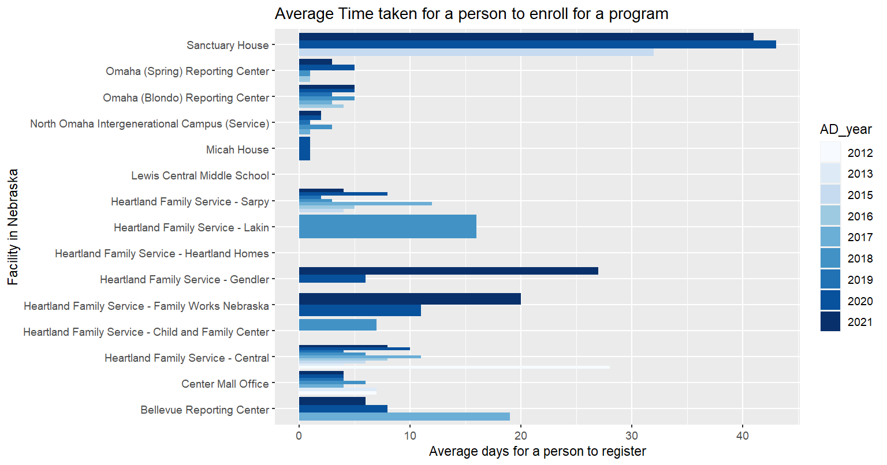
Review made based on Our analysis in Nebraska

Slide 9
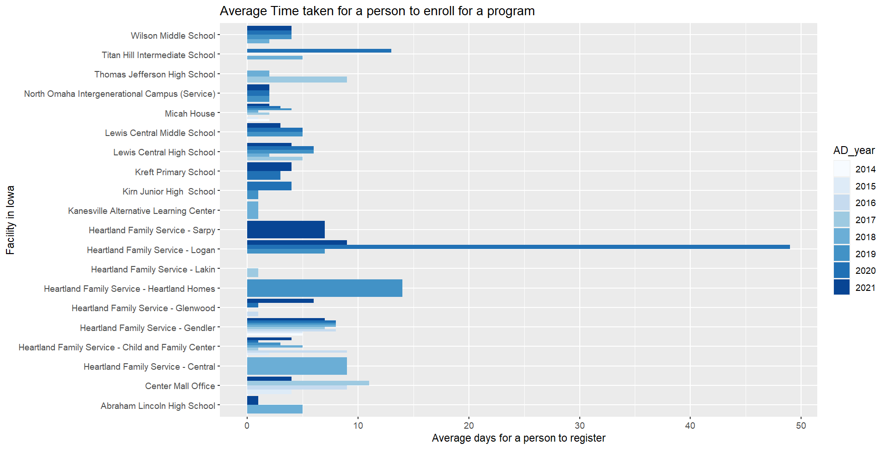
Review made based on Our analysis in Iowa

Slide 10
Why?..
We are unsure why we observe a large variance in the time required for patient data registration/submission/approved enrollment.
Covid might have affected the process. However, we noticed large differences in enrollment delays based on location.

Slide 11
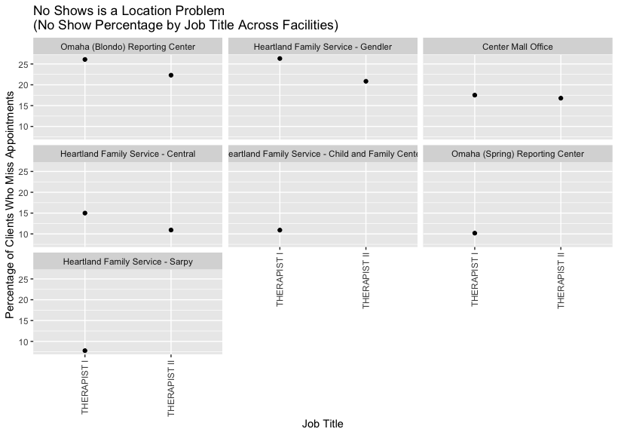
Our results and interpretations of the data?
Missed appointments are closely related to the facility.
Slight differences in missed appointments by the type of therapist (I vs II).

Slide 12
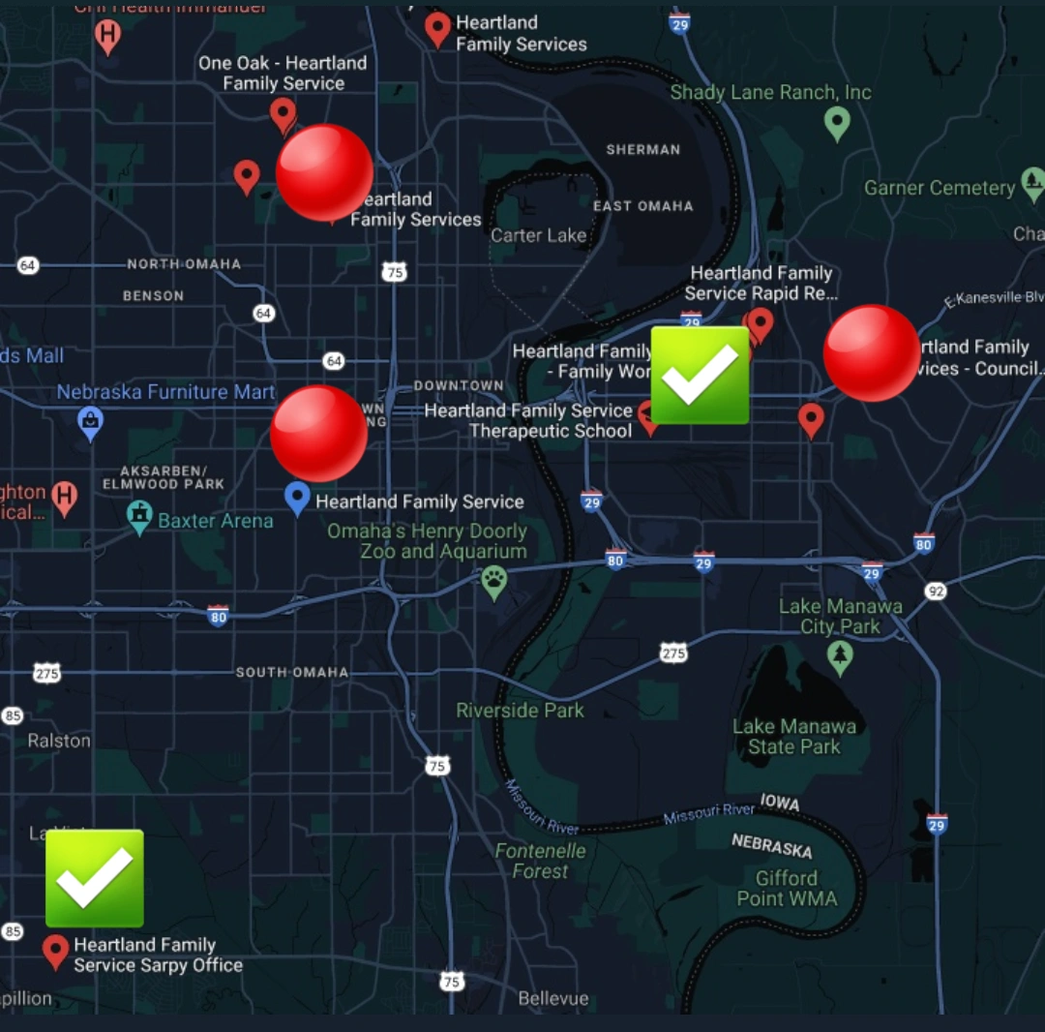
What decisions should be made based on Our analysis?
Further research is required to understand the stark difference in missed appointments.
It would be interesting to explore more detailed Target demographics for each area.

Slide 13
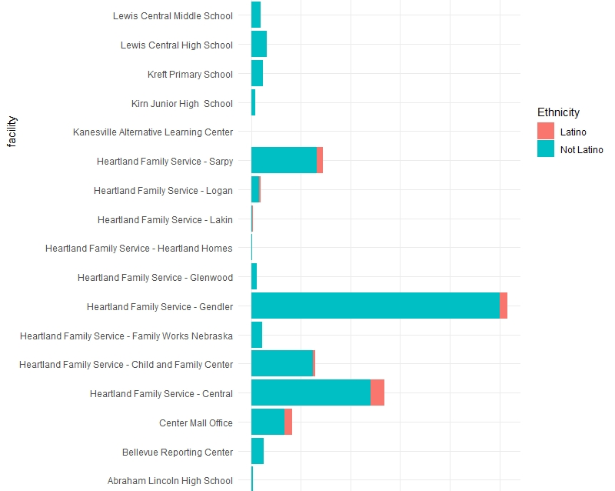
Ethnicity by Location
Notes:
The majority of Latino clients received services at the North Omaha Campus and at the HFS-Central location. HFS should look at staffing these two facilities with bi-lingual (Spanish) therapists and receptionists. HFS could possibly benefit by having the bilingual staff at the Sarpy Office as well so that there are 3 branches throughout the metro area to serve Latino clients.

Slide 14
Summary
RQ1: Different facilities have significantly different delays. Schools have an especially fast enrollment process but counties are slower.
RQ2: The rate of missed appointments is different, based on the facility. We also observe consistent differences in missed appointments by the type of therapist (I vs II).
RQ3: HFS might benefit by having bilingual staff at the Sarpy office too. Therefore, there would be three branches throughout the metro area that serve Latino clients

